Slide 1
Vishwakarma University
FYBSc Computer Science
Sem II
BSCCS24203
Database Management System
Unit 4
SQL

Slide 2
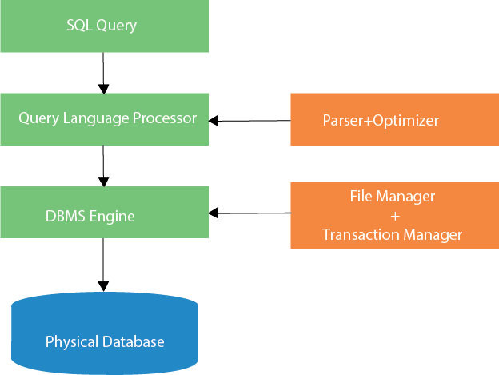
SQL stands for Structured Query Language. It is used for storing and managing data in relational database management system (RDMS). In RDBMS data stored in the form of the tables.
How does SQL process works:

Slide 3
Query Parsing
Input: The SQL statement provided by the user (e.g., SELECT * FROM Students WHERE Age > 20;).
Tasks Performed: Syntax Check: Ensures the SQL statement is syntactically correct.
Semantic Check: Verifies if the database objects (tables, columns, etc.) referenced in the query exist and that the user has sufficient permissions.
The DBMS generates a "query tree" to represent the structure of the query.
b. Query Optimization
Goal: Improve query performance by determining the most efficient way to execute the SQL statement.
Tasks Performed:
Evaluate different query execution plans.
Choose the best plan based on factors like indexes, table size, and available system resources. Consider optimizations like: Using indexes for faster lookups.
Reordering joins to reduce intermediate results. Filtering data as early as possible.
c. Query Execution Plan: The DBMS uses the optimized plan to perform the actual query operations.
Execution Engine: Reads data from tables. Applies filters, joins, and aggregations. Returns the results to the user.

Slide 4
Popular SQL Database Systems
MySQL: Open-source and widely used for web applications.
PostgreSQL: Advanced features and high reliability.
Microsoft SQL Server: Enterprise-level database with robust tools.
Oracle Database: Scalable, enterprise-grade database system.
SQLite: Lightweight, serverless database often used in mobile applications.

Slide 5
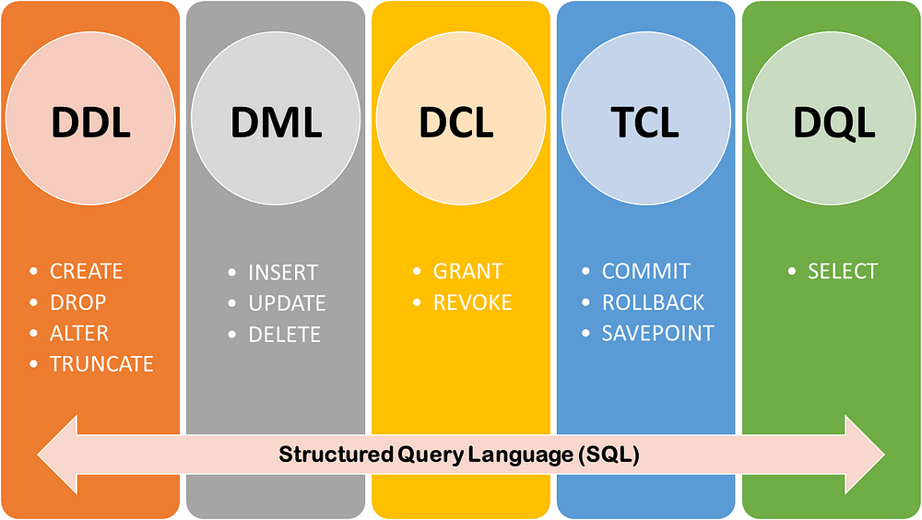
SQL Commands

Slide 6
Data Definition Language (DDL)
DDL commands define and modify the structure of database objects like tables, indexes, and schemas.
CREATE
Used to create a new database or table.
Syntax:
CREATE TABLE table_name (
column1 datatype constraint,
column2 datatype constraint,
...);
Example
CREATE TABLE Employees (
EmployeeID INT PRIMARY KEY,
Name VARCHAR(50),
Age INT,
Department VARCHAR(50)
);

Slide 7
b. ALTER
Used to modify an existing table's structure (e.g., add, drop or rename columns).
Syntax:
ALTER TABLE table_name
ADD column_name datatype constraint;
ALTER TABLE table_name
DROP COLUMN column_name;
ALTER TABLE table_name
MODIFY COLUMN column_name datatype;
ALTER TABLE old_table_name
RENAME new_table_name;
ALTER TABLE table_name
DROP COLUMN column_name;
Example:
ALTER TABLE Employees
ADD Salary DECIMAL(10, 2);

Slide 8
c. DROP
Used to delete an existing database or table.
Syntax:
DROP TABLE table_name;
Example:
DROP TABLE Employees;

Slide 9
2. Data Manipulation Language (DML)
DML commands are used to manipulate data within tables.
INSERT
Used to add new rows to a table.
Syntax:
INSERT INTO table_name
(column1, column2, ...)
VALUES
(value1, value2, ...);
Example:
INSERT INTO Employees (EmployeeID, Name, Age, Department, Salary)
VALUES (1, 'John Doe', 30, 'IT', 60000.00);

Slide 10
b. UPDATE
Used to modify existing rows in a table.
Syntax:
UPDATE table_name
SET column1 = value1, column2 = value2, ...
WHERE condition;
Example:
UPDATE Employees
SET Salary = 65000.00
WHERE EmployeeID = 1;
c. DELETE
Used to delete rows from a table.
Syntax:
DELETE FROM table_name
WHERE condition;
Example:
DELETE FROM Employees
WHERE Age < 25;

Slide 11
3. Data Query Language
SELECT
Used to retrieve data from a table.
Syntax:
SELECT column1, column2, ...
FROM table_name
WHERE condition;
Example:
SELECT Name, Department
FROM Employees
WHERE Age > 25;

Slide 12
4. Data Control Language (DCL)
DCL commands manage user access and permissions.
GRANT
Provides specific privileges to a user.
Syntax:
GRANT privilege ON object TO user;
Example:
GRANT SELECT, INSERT ON Employees TO User1;
b. REVOKE
Removes specific privileges from a user.
Syntax:
REVOKE privilege ON object FROM user;
Example:
REVOKE INSERT ON Employees FROM User1;

Slide 13
5. Transaction Control Language (TCL)
TCL commands manage transactions in the database.
COMMIT
Saves the current transaction permanently.
Syntax:
COMMIT;
Example:
INSERT INTO Employees (EmployeeID, Name, Age, Department, Salary)
VALUES (2, 'Jane Smith', 28, 'HR', 55000.00);
COMMIT;
b. ROLLBACK
Undoes the current transaction.
Syntax:sqlCopyROLLBACK;
Example:
DELETE FROM Employees
WHERE Department = 'HR’;
ROLLBACK;

Slide 14
c. SAVEPOINT
Sets a savepoint within a transaction, allowing partial rollbacks.
Syntax:
SAVEPOINT savepoint_name;
Example:
SAVEPOINT Savepoint1;
UPDATE Employees
SET Salary = 70000.00
WHERE EmployeeID = 1;
ROLLBACK TO Savepoint1;

Slide 15
MySQL Constraints
The constraint in MySQL is used to specify the rule that allows or restricts what values/data will be stored in the table.
They provide a suitable method to ensure data accuracy and integrity inside the table.
It also helps to limit the type of data that will be inserted inside the table.
If any interruption occurs between the constraint and data action, the action is failed.
Constraints used in MySQL
The following are the most common constraints used in the MySQL:
NOT NULL
CHECK
DEFAULT
PRIMARY KEY
AUTO_INCREMENT
UNIQUE
INDEX
ENUM
FOREIGN KEY

Slide 16
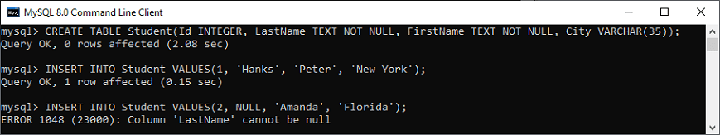
NOT NULL Constraint
This constraint specifies that the column cannot have NULL or empty values.
mysql> CREATE TABLE Student(
Id INTEGER,
LastName TEXT NOT NULL,
FirstName TEXT NOT NULL,
City VARCHAR(35));
Execute the queries listed below to understand how it works:
mysql> INSERT INTO Student VALUES(1, 'Hanks', 'Peter', 'New York');
mysql> INSERT INTO Student VALUES(2, NULL, 'Amanda', 'Florida');

Slide 17
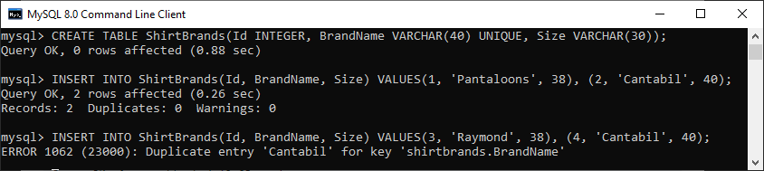
UNIQUE Constraint
This constraint ensures that all values inserted into the column will be unique. It means a column cannot stores duplicate values. MySQL allows us to use more than one column with UNIQUE constraint in a table.
mysql> CREATE TABLE ShirtBrands(Id INTEGER, BrandName VARCHAR(40) UNIQUE, Size VARCHAR(30));
Execute the queries listed below to understand how it works:
mysql> INSERT INTO ShirtBrands VALUES(1, 'Pantaloons', 38), (2, 'Cantabil', 40);
mysql> INSERT INTO ShirtBrands VALUES(3, 'Raymond', 38), (4, 'Cantabil', 40);

Slide 18
CHECK Constraint
It controls the value in a particular column. It ensures that the inserted value in a column must be satisfied with the given condition.
[CONSTRAINT [symbol]] CHECK (expr) [[NOT] ENFORCED]
For example, the following statement creates a table "Persons" that contains CHECK constraint on the "Age" column. The CHECK constraint ensures that the Age of a person should be greater than or equal to 18:
mysql> CREATE TABLE Persons (
ID int NOT NULL,
Name varchar(45) NOT NULL,
Age int CHECK (Age>=18)
);
Execute the listed queries to insert the values into the table:
mysql> INSERT INTO Persons(Id, Name, Age)
VALUES (1,'Robert', 28), (2, 'Joseph', 35), (3, 'Peter', 40);
mysql> INSERT INTO Persons(Id, Name, Age) VALUES (1,'Robert', 15);

Slide 19
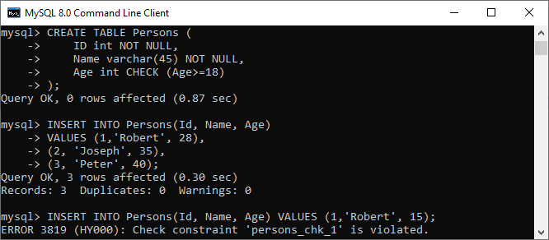

Slide 20
CREATE TABLE Persons (
ID int NOT NULL,
LastName varchar(255) NOT NULL,
FirstName varchar(255),
Age int,
City varchar(255),
CONSTRAINT CHK_Person CHECK (Age>=18 AND City='Sandnes')
);
OR
ALTER TABLE Persons
ADD CHECK (Age>=18);
ALTER TABLE Persons
ADD CONSTRAINT CHK_PersonAge CHECK (Age>=18 AND City='Sandnes’);
ALTER TABLE Persons
DROP CHECK CHK_PersonAge;

Slide 21
DEFAULT Constraint
This constraint is used to set the default value for the particular column where we have not specified any value. It means the column must contain a value, including NULL.
For example, the following statement creates a table "Persons" that contains DEFAULT constraint on the "City" column. If we have not specified any value to the City column, it inserts the default value:
mysql> CREATE TABLE Persons (
ID int NOT NULL,
Name varchar(45) NOT NULL,
Age int,
City varchar(25) DEFAULT 'New York'
);
Execute the listed queries to insert the values into the table:
mysql> INSERT INTO Persons(Id, Name, Age, City)
VALUES (1,'Robert', 15, 'Florida'),
(2, 'Joseph', 35, 'California'),
(3, 'Peter', 40, 'Alaska');
mysql> INSERT INTO Persons(Id, Name, Age) VALUES (1,'Brayan', 15);

Slide 22
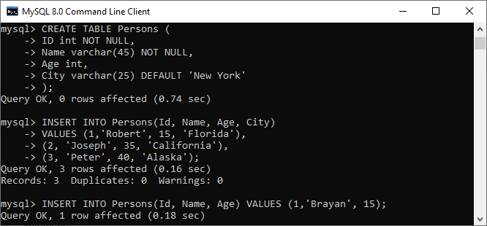
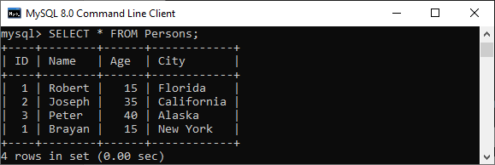

Slide 23
PRIMARY KEY Constraint
This constraint is used to identify each record in a table uniquely. If the column contains primary key constraints, then it cannot be null or empty. A table may have duplicate columns, but it can contain only one primary key. It always contains unique value into a column.
The following statement creates a table "Person" and explains the use of this primary key more clearly:
CREATE TABLE Persons (
ID int NOT NULL PRIMARY KEY,
Name varchar(45) NOT NULL,
Age int,
City varchar(25));
Next, use the insert query to store data into a table:
INSERT INTO Persons(Id, Name, Age, City)
VALUES (1,'Robert', 15, 'Florida') ,
(2, 'Joseph', 35, 'California'),
(3, 'Peter', 40, 'Alaska');
INSERT INTO Persons(Id, Name, Age, City)
VALUES (1,'Stephen', 15, 'Florida');

Slide 24
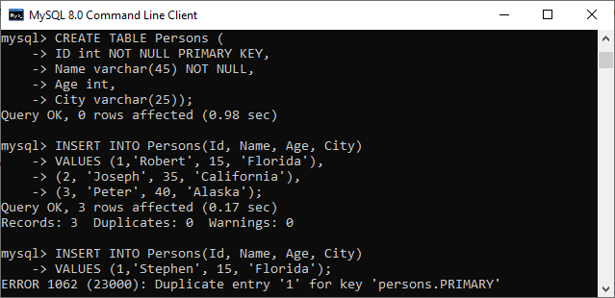

Slide 25
AUTO_INCREMENT Constraint
This constraint automatically generates a unique number whenever we insert a new record into the table. Generally, we use this constraint for the primary key field in a table.
mysql> CREATE TABLE Animals(
id int NOT NULL AUTO_INCREMENT,
name CHAR(30) NOT NULL,
PRIMARY KEY (id));
Next, we need to insert the values into the "Animals" table:
mysql> INSERT INTO Animals (name) VALUES
('Tiger'),('Dog'),('Penguin'),
('Camel'),('Cat'),('Ostrich’);
Now, execute the below statement to get the table data:
mysql> SELECT * FROM Animals;

Slide 26
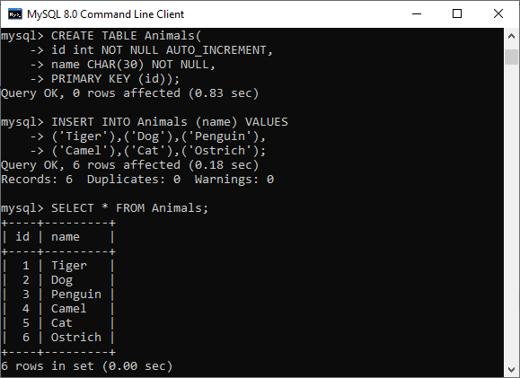

Slide 27
ENUM Constraint
The ENUM data type in MySQL is a string object. It allows us to limit the value chosen from a list of permitted values in the column specification at the time of table creation. It is short for enumeration, which means that each column may have one of the specified possible values. It uses numeric indexes (1, 2, 3…) to represent string values.
The following illustration creates a table named "shirts" that contains three columns: id, name, and size. The column name "size" uses the ENUM data type that contains small, medium, large, and x-large sizes.
mysql> CREATE TABLE Shirts (
id INT PRIMARY KEY AUTO_INCREMENT,
name VARCHAR(35),
size ENUM('small', 'medium', 'large', 'x-large')
);
mysql> INSERT INTO Shirts(id, name, size)
VALUES (1,'t-shirt', 'medium'),
(2, 'casual-shirt', 'small'),
(3, 'formal-shirt', 'large’);
Now, execute the SELECT statement to see the inserted values into the table:
mysql> SELECT * FROM Shirts;

Slide 28
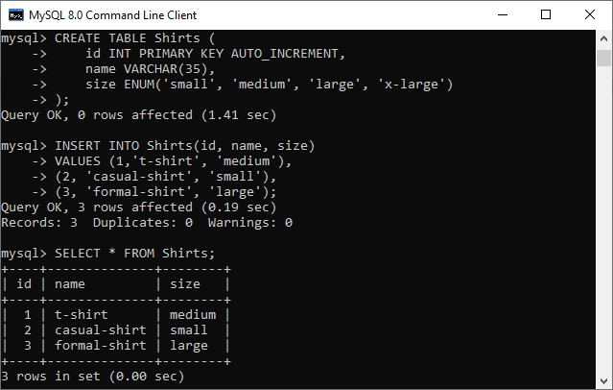

Slide 29
INDEX Constraint
An index is a database object that improves the speed of data retrieval operations on a table.
While indexes are not constraints in a strict sense, they are often associated with constraints like PRIMARY KEY, UNIQUE, and others because these constraints automatically create indexes behind the scenes.
Indexes are used to enhance query performance by reducing the time taken to locate rows in a table.
Purpose: To speedup query filtering
Syntax:
CREATE INDEX index_name ON table_name (column1, column2);
DROP INDEX index_name ON table_name;
Example:
CREATE INDEX idx_name ON Employees (Name);
CREATE INDEX idx_department_salary ON Employees (Department, Salary);
CREATE UNIQUE INDEX idx_email ON Employees (Email);
Disadvantage: Slows down INSERT, UPDATE, and DELETE operations because the index needs to be updated. Consumes additional disk space.

Slide 30
Foreign Key Constraint
This constraint is used to link two tables together. It is also known as the referencing key. A foreign key column matches the primary key field of another table. It means a foreign key field in one table refers to the primary key field of another table.
Let us consider the structure of these tables: Persons and Orders.
Table: Persons
CREATE TABLE Persons (
Person_ID int NOT NULL PRIMARY KEY,
Name varchar(45) NOT NULL,
Age int,
City varchar(25)
);
Table: Orders
CREATE TABLE Orders (
Order_ID int NOT NULL PRIMARY KEY,
Order_Num int NOT NULL,
Person_ID int,
FOREIGN KEY (Person_ID) REFERENCES Persons(Person_ID)
);

Slide 31
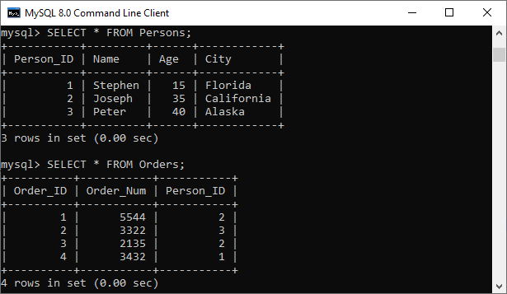

Slide 32
Aggregate Functions
Used to perform calculations on multiple values and return the result in a single value like the average of all values, the sum of all values, and maximum & minimum value among certain groups of values.
Aggregate Function | Descriptions
count() | It returns the number of rows, including rows with NULL values in a group.
sum() | It returns the total summed values (Non-NULL) in a set.
average() | It returns the average value of an expression.
min() | It returns the minimum (lowest) value in a set.
max() | It returns the maximum (highest) value in a set.
groutp_concat() | It returns a concatenated string.
first() | It returns the first value of an expression.
last() | It returns the last value of an expression.

Slide 33
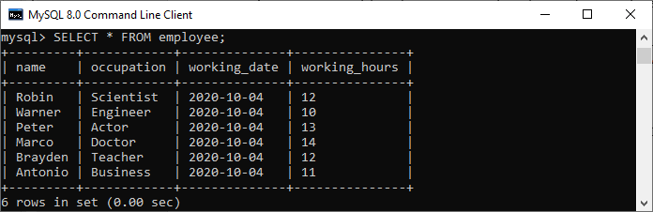
CREATE TABLE employee(
name varchar(45) NOT NULL,
occupation varchar(35) NOT NULL,
working_date date,
working_hours varchar(10)
);
INSERT INTO employee VALUES
('Robin', 'Scientist', '2020-10-04', 12),
('Warner', 'Engineer', '2020-10-04', 10),
('Peter', 'Actor', '2020-10-04', 13),
('Marco', 'Doctor', '2020-10-04', 14),
('Brayden', 'Teacher', '2020-10-04', 12),
('Antonio', 'Business', '2020-10-04', 11);

Slide 34
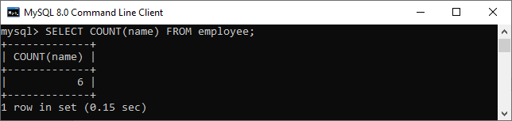
Count() Function
MySQL count() function returns the total number of values in the expression.
This function produces all rows or only some rows of the table based on a specified condition, and its return type is BIGINT.
It returns zero if it does not find any matching rows. It can work with both numeric and non-numeric data types.
Example
Suppose we want to get the total number of employees in the employee table
mysql> SELECT COUNT(name) FROM employee;

Slide 35
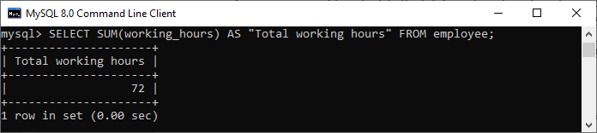
Sum() Function
The MySQL sum() function returns the total summed (non-NULL) value of an expression. It returns NULL if the result set does not have any rows. It works with numeric data type only.
Suppose we want to calculate the total number of working hours of all employees
mysql> SELECT SUM(working_hours) AS "Total working hours" FROM employee;

Slide 36
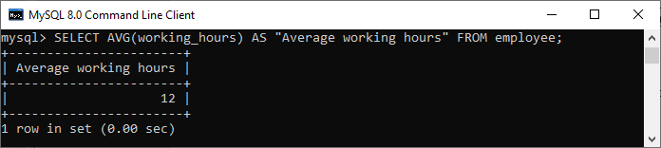
AVG() Function
MySQL AVG() function calculates the average of the values specified in the column. Similar to the SUM() function, it also works with numeric data type only.
Suppose we want to get the average working hours of all employees
mysql> SELECT AVG(working_hours) AS "Average working hours" FROM employee;

Slide 37
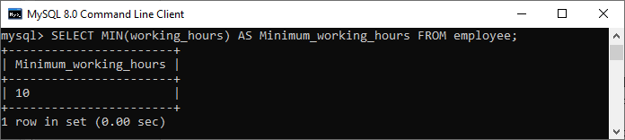
MIN() Function
MySQL MIN() function returns the minimum (lowest) value of the specified column. It also works with numeric data type only.
Suppose we want to get minimum working hours of an employee
mysql> SELECT MIN(working_hours) AS Minimum_working_hours FROM employee;

Slide 38
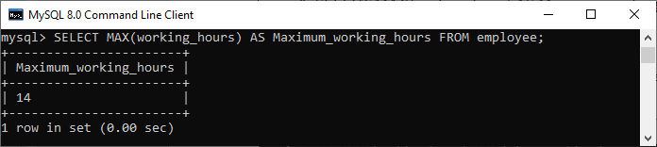
MAX() Function
MySQL MAX() function returns the maximum (highest) value of the specified column. It also works with numeric data type only.
Suppose we want to get maximum working hours of an employee
mysql> SELECT MAX(working_hours) AS Maximum_working_hours FROM employee;

Slide 39
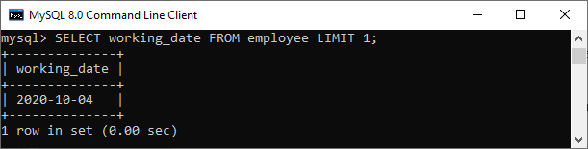
FIRST() Function
This function returns the first value of the specified column. To get the first value of the column, we must have to use the LIMIT clause. It is because FIRST() function only supports in MS Access.
Suppose we want to get the first working date of an employee available in the table, we need to use the following query:
mysql> SELECT working_date FROM employee LIMIT 1;

Slide 40
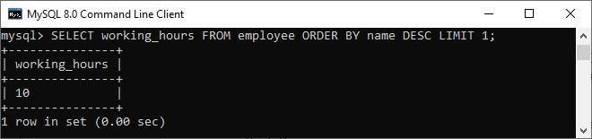
LAST() Function
This function returns the last value of the specified column. To get the last value of the column, we must have to use the ORDER BY and LIMIT clause. It is because the LAST() function only supports in MS Access.
Suppose we want to get the last working hour of an employee
mysql> SELECT working_hours FROM employee ORDER BY name DESC LIMIT 1;

Slide 41
Built-In Functions in MySQL – Numeric, String and Date Time
Function | Explanation | Syntax | Example | Output
POWER() | Returns the value of a number raised to the power of another number. | POWER(base, exponent) | SELECT POWER(2, 3); | 8
FLOOR() | Returns the largest integer less than or equal to the number. | FLOOR(number) | SELECT FLOOR(4.7); | 4
CEIL() | Returns the smallest integer greater than or equal to the number. | CEIL(number) | SELECT CEIL(4.2); | 5
ROUND() | Rounds a number to a specified number of decimal places. | ROUND(number, decimals) | SELECT ROUND(3.14159, 2); | 3.14
ABS() | Returns the absolute (positive) value of a number. | ABS(number) | SELECT ABS(-25); | 25

Slide 42
Function | Explanation | Syntax | Example | Output
CONCAT() | Combines two or more strings into a single string. | CONCAT(string1, string2, ...) | SELECT CONCAT('Hello', ' ', 'World'); | Hello World
UPPER() | Converts all characters in a string to uppercase. | UPPER(string) | SELECT UPPER('hello'); | HELLO
LOWER() | Converts all characters in a string to lowercase. | LOWER(string) | SELECT LOWER('HELLO'); | Hello
SUBSTRING() | Extracts a substring from a string, starting at a specified position. | SUBSTRING(string, start, length) | SELECT SUBSTRING('Hello World', 7, 5); | World
LENGTH() | Returns the length of a string in bytes. | LENGTH(string) | SELECT LENGTH('MySQL'); | 5

Slide 43
Function | Explanation | Syntax | Example | Output
DATE_FORMAT() | Formats a date value according to a specified format. | DATE_FORMAT(date, format) | SELECT DATE_FORMAT('2025-01-27', '%d/%m/%Y'); | 27/01/2025
DATE_ADD() | Adds a time interval to a date. | DATE_ADD(date, INTERVAL value unit) | SELECT DATE_ADD('2025-01-27', INTERVAL 5 DAY); | 2025-02-01
DATEDIFF() | Returns the number of days between two dates. | DATEDIFF(date1, date2) | SELECT DATEDIFF('2025-02-01', '2025-01-27'); | 5
CURDATE() | Returns the current date. | CURDATE() | SELECT CURDATE(); | 2025-01-27
NOW() | Returns the current date and time. | NOW() | SELECT NOW(); | 2025-01-27 14:30:00 (example)

Slide 44
Subqueries in MySQL
A subquery is a query nested within another query, used to perform operations that depend on the result of the outer query.
Subqueries can be placed in different parts of a query, such as the SELECT, FROM, or WHERE clause.
Type | Explanation | Example
Single-row Subquery | Returns only one row of results. Used with operators like =, <, >, etc. | sql SELECT name FROM employees WHERE salary > (SELECT AVG(salary) FROM employees);
 | Give name of employees who’s salary is greater than average salary of all employees.
Multi-row Subquery | Returns multiple rows of results. Used with operators like IN, ANY, ALL, etc. | sql SELECT name FROM employees WHERE department_id IN (SELECT id FROM departments WHERE location = 'NY');
 | Find the names of employees who work in departments located in 'NY'.

Slide 45
Correlated Subquery | References columns from the outer query. Executed once for each row of the outer query. | sql SELECT e.name FROM employees e WHERE e.salary > (SELECT AVG(salary) FROM employees WHERE department_id = e.department_id);
 | find the names of employees who earn more than the average salary of their respective departments.
Subquery in SELECT | Used to calculate a value for each row of the outer query. | sql SELECT name, (SELECT COUNT(*) FROM projects WHERE projects.employee_id = employees.id) AS project_count FROM employees;
 | retrieve the names of employees along with the number of projects they are associated with.
Subquery in FROM | Acts as a temporary table. | sql SELECT avg_salary FROM (SELECT department_id, AVG(salary) AS avg_salary FROM employees GROUP BY department_id) AS dept_avg;
 | calculate the average salary for each department and display only the average salaries.

Slide 46
Practice Questions
Find employees earning more than the average salary:
SELECT name, salaryFROM employeesWHERE salary > (SELECT AVG(salary) FROM employees);
List all departments with more than 5 employees:
SELECT department_nameFROM departmentsWHERE id IN (SELECT department_id FROM employees GROUP BY department_id HAVING COUNT(*) > 5);
Get the top salary in each department using correlated subquery:
SELECT e.name, e.salary, e.department_idFROM employees eWHERE e.salary = (SELECT MAX(salary) FROM employees WHERE department_id = e.department_id);
Using a subquery as a temporary table in FROM:
SELECT department_id, avg_salaryFROM (SELECT department_id, AVG(salary) AS avg_salary FROM employees GROUP BY department_id) AS dept_avgWHERE avg_salary > 50000;

Slide 47
Use of group by, having, order by
These clauses are essential for organizing and filtering aggregated data in a query.
Clause | Purpose | Key Notes
HAVING | Filters the grouped data (acts like WHERE for aggregated data). | - Used after GROUP BY. - Can include aggregate functions (unlike WHERE).
GROUP BY | Groups rows that have the same values into summary rows, such as calculating aggregates (e.g., SUM, AVG). | - Used with aggregate functions. - Must appear after FROM and before ORDER BY.
ORDER BY | Sorts the results in ascending (ASC) or descending (DESC) order. | - Applied to grouped or ungrouped data. - Appears after GROUP BY and HAVING.

Slide 48
Syntax:
SELECT column1, aggregate_function(column2)
FROM table
WHERE condition
GROUP BY column1
HAVING condition
ORDER BY column1 [ASC|DESC];

Slide 49
Using GROUP BY:
Question: Find the total salary for each department.
SELECT department_id, SUM(salary) AS total_salary
FROM employees
GROUP BY department_id;
Using HAVING:
Question: Find departments where the total salary exceeds 50,000.
SELECT department_id, SUM(salary) AS total_salary
FROM employees
GROUP BY department_id
HAVING SUM(salary) > 50000;

Slide 50
Using ORDER BY:
Question: Display employees' names and salaries in descending order of salary
SELECT name, salary
FROM employees
ORDER BY salary DESC;
Combining GROUP BY, HAVING, and ORDER BY:
Question: Find departments with more than 5 employees, sorted by total salary in descending order.
SELECT department_id, COUNT(*) AS employee_count, SUM(salary) AS total_salary
FROM employees
GROUP BY department_id
HAVING COUNT(*) > 5
ORDER BY total_salary DESC;

Slide 51
Key Differences:
GROUP BY groups data into categories.
HAVING filters grouped results (e.g., applying conditions on SUM, COUNT, etc.).
ORDER BY organizes the final output in a specified order.

